Slide 1
Final Presentation
COSC 402-01 SP24

Slide 2
Project Management

Slide 3
Lillian Greenberg
Document Review
Flier
Backlog
Traceability Matrix
Communications
Link between customer and team
Emails with parisa
Updates
Questions & Feedback
Meetings
Previous customer
Coordinate meeting time
Coordinate meeting room
Role Assignment
Review all resumes and cover letters
Interview each team member
Identify best fit
Weekly Duties
Scrums
Consolidating reports
Document/Template Creation
Presentations
Backlog

Slide 4
Research & Development

Slide 5
Alexander Stoyanov-Roberts
RnD Team Lead
Communicated with QA to ensure site is well documented and set for transfer next semester.
Fully Transferred Azure Site to Django
Removed Azure deployment, and imported all the features into the Django site.
Overall HTML overhaul of the site at the start of the semester to standardize the site

Slide 6
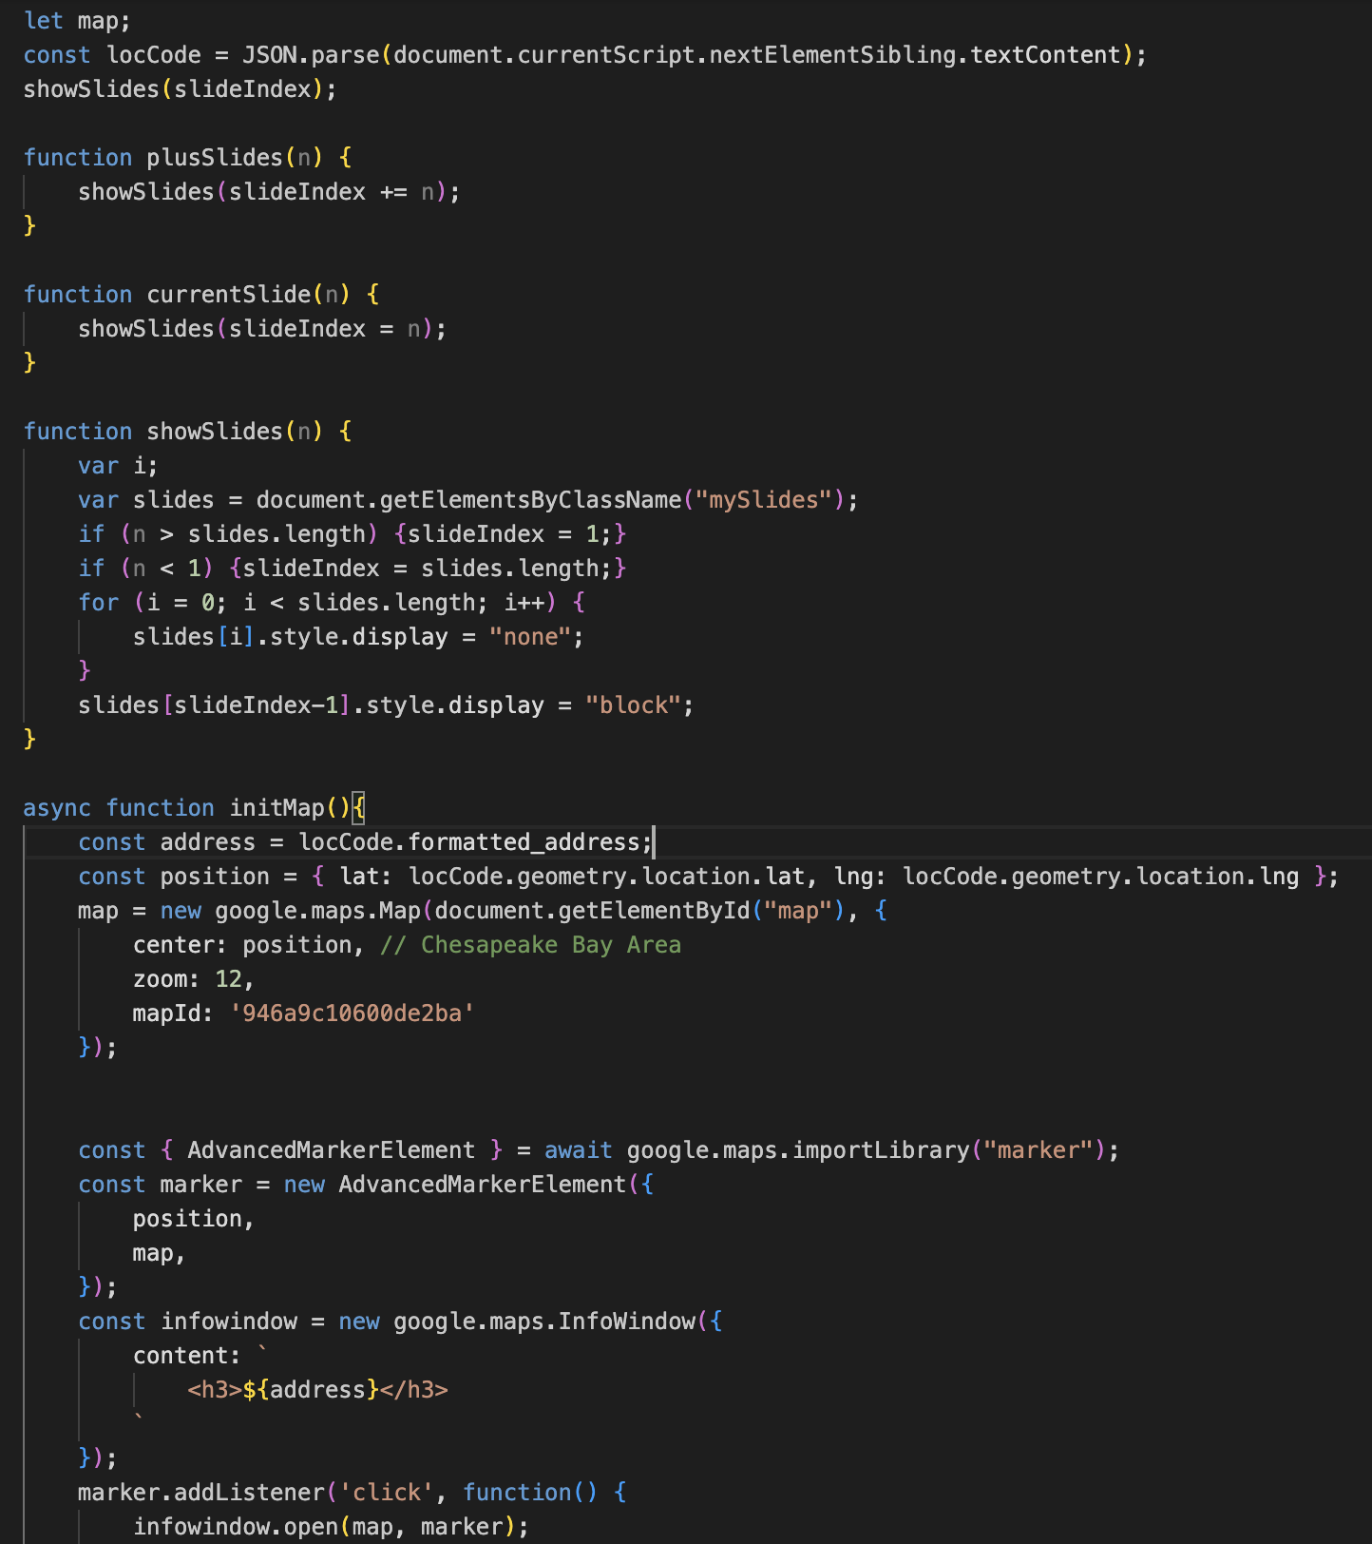
Alexander Stoyanov-Roberts
Slideshow Container:
Created a Slideshow container for user content
All images are resized to fit the same way
Slideshow Includes map with Pin location
MultiMedia Uploads:
Assisted with implementing Multimedia Uploads
Google Map Directions:
Created a now removed Google Maps feature

Slide 7
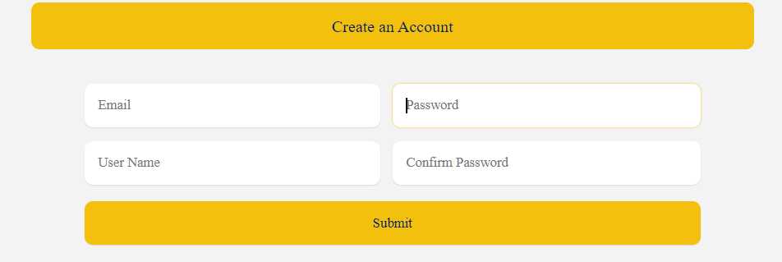
Jeffrey Wood
Front End Adjustments
Moved Contact Us to Help,
reducing amount of pages
Create An Account
Set up the Create An Account Form
Worked on the form with Roman
Added a Confirm Password Feature so no wrong data is sent

Slide 8
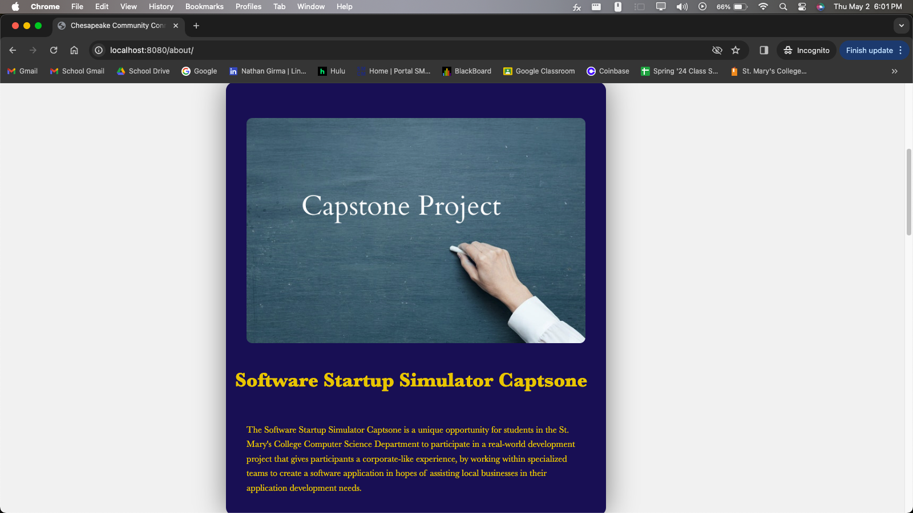
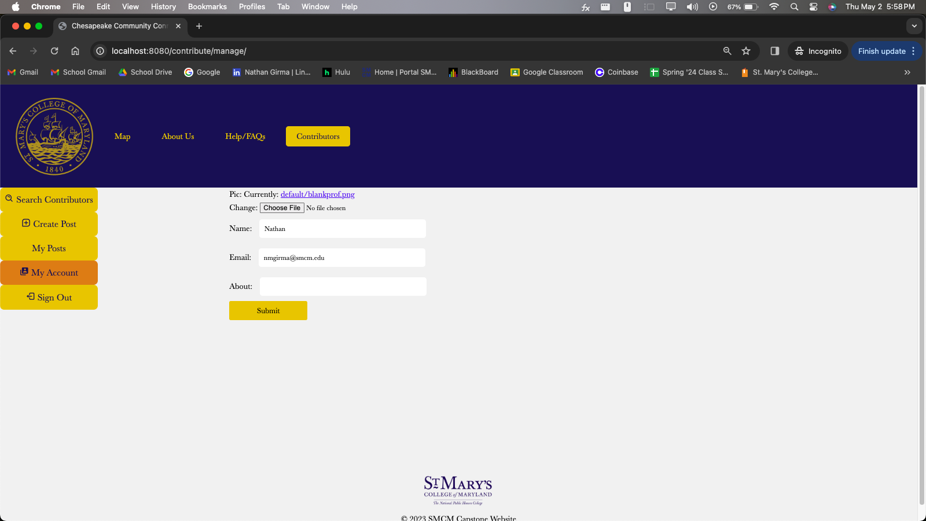
Nathan Girma
Front-End Design:
HTML
CSS
Pages I worked On:
About Us Page
Created sections for Descriptions for each team
Contributors/My Account Page

Slide 9
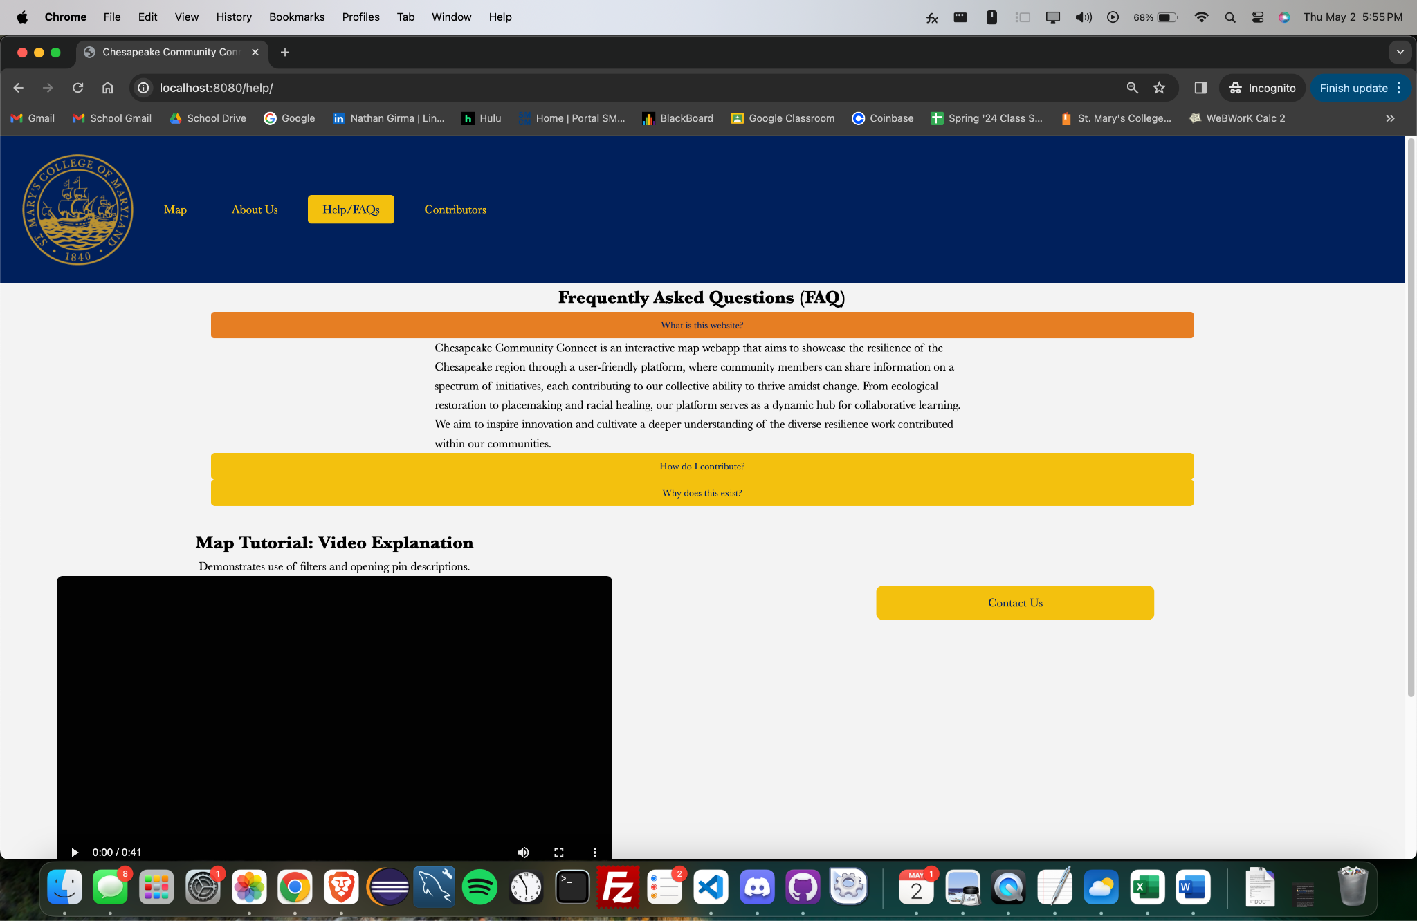
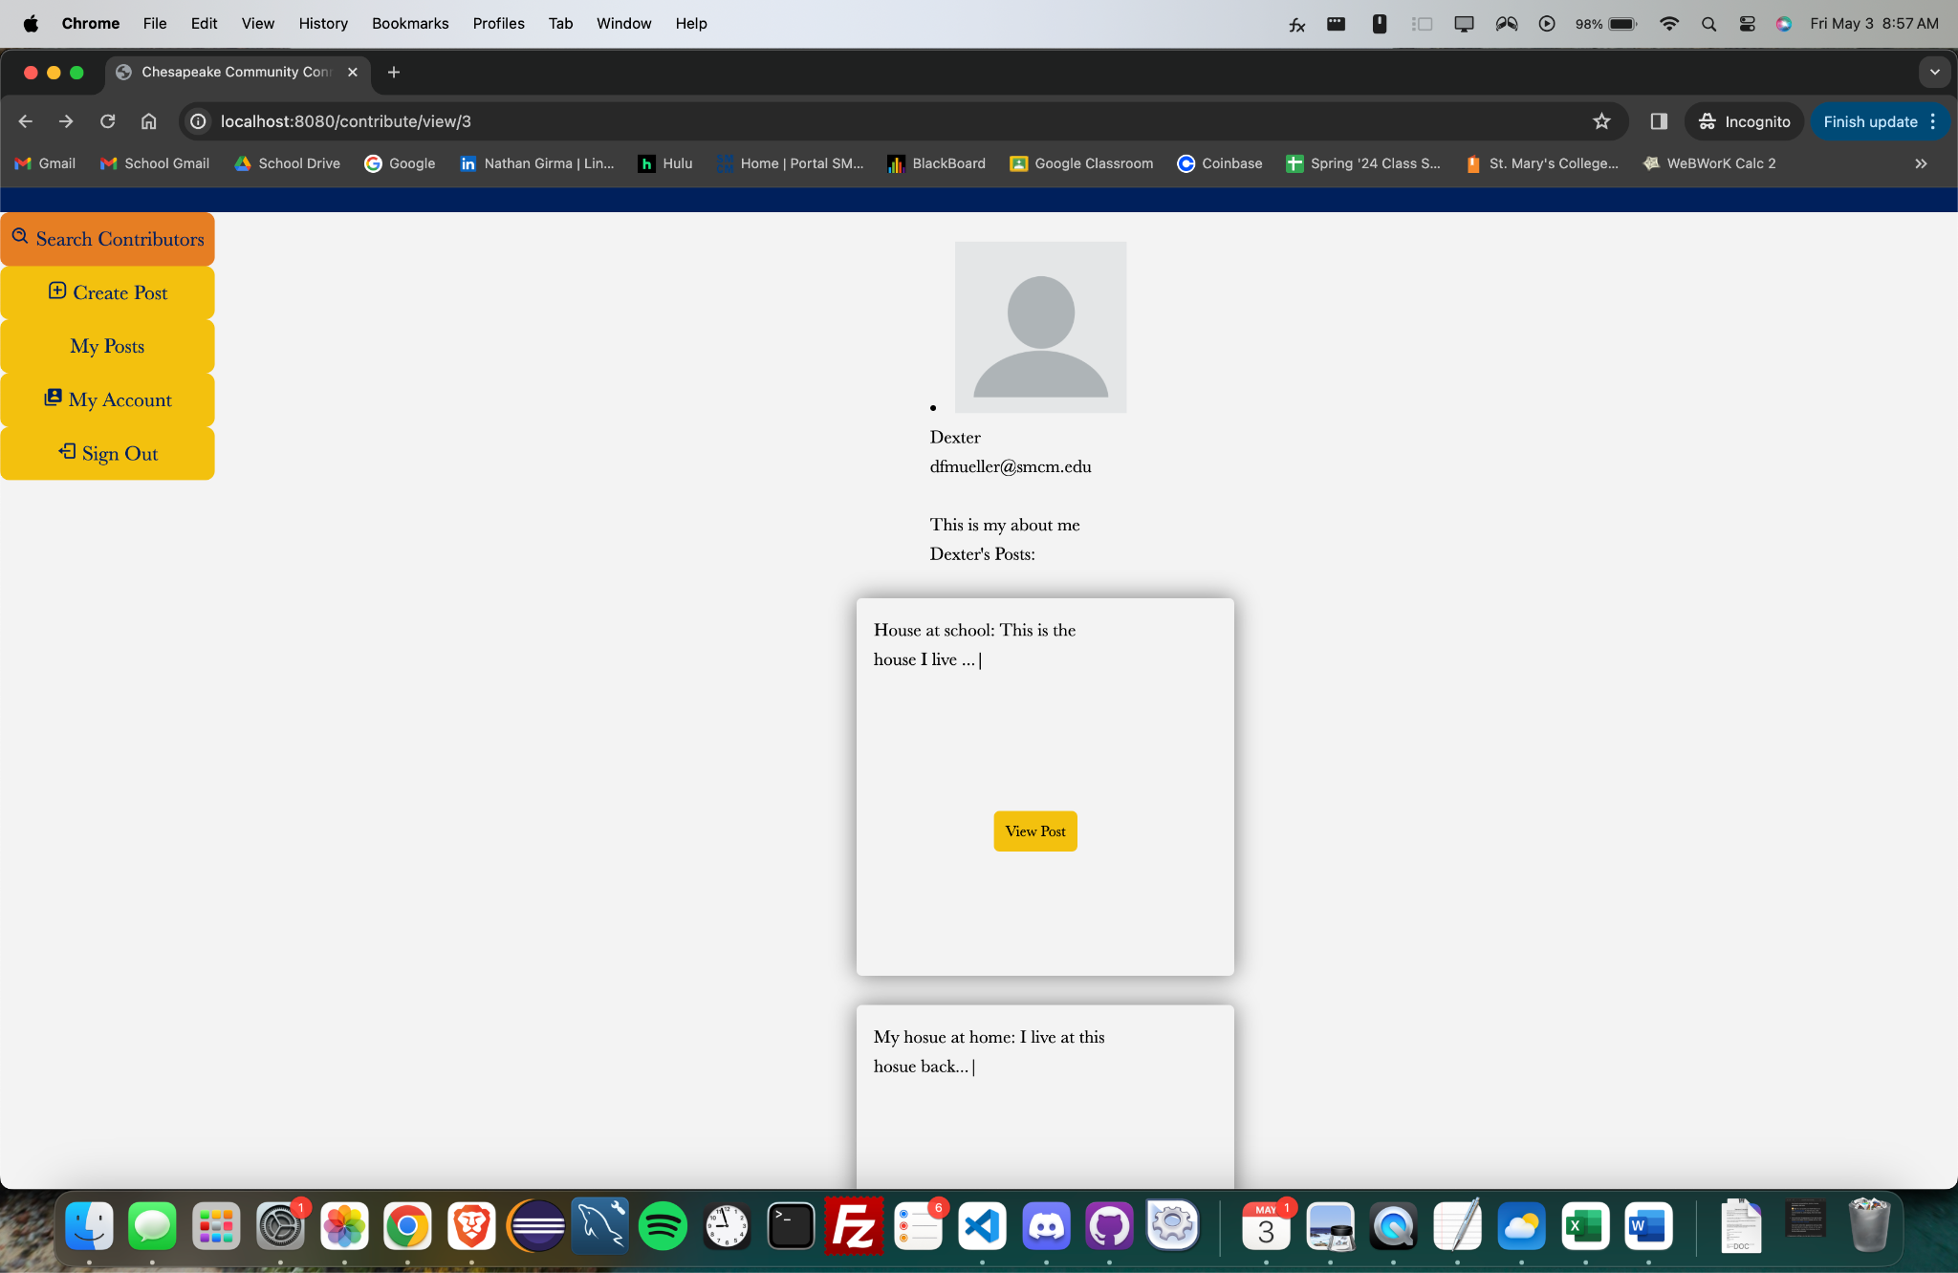
Nathan Girma
FAQ Page
Made accordions more interactive
Re-formatted page
Search Contributors Page
Styled Page where User’s visible posts are shown

Slide 10
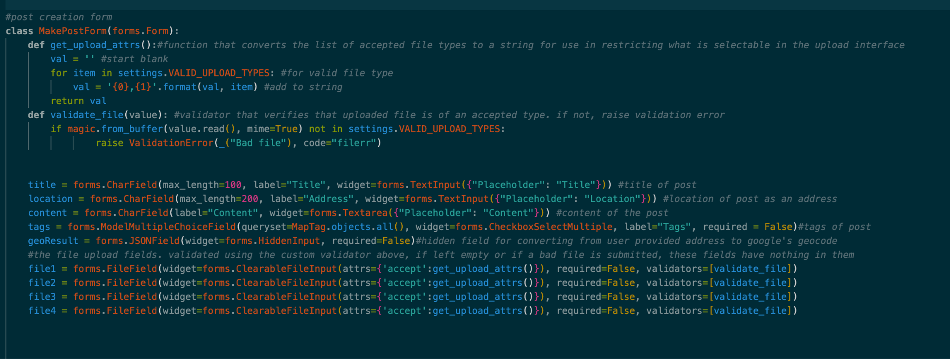
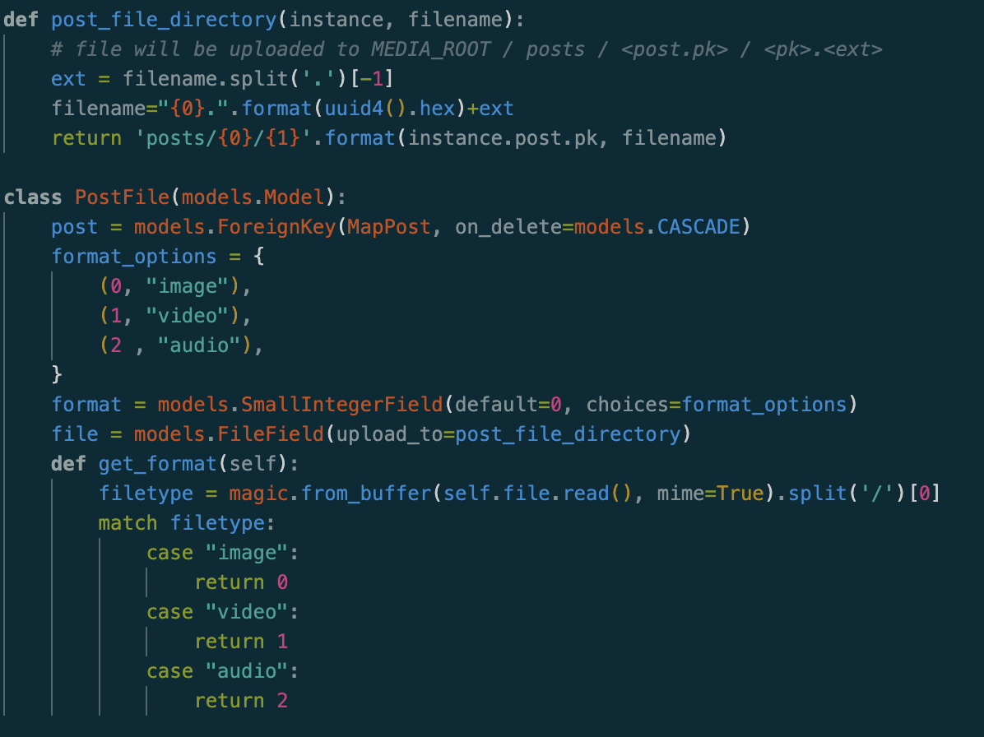
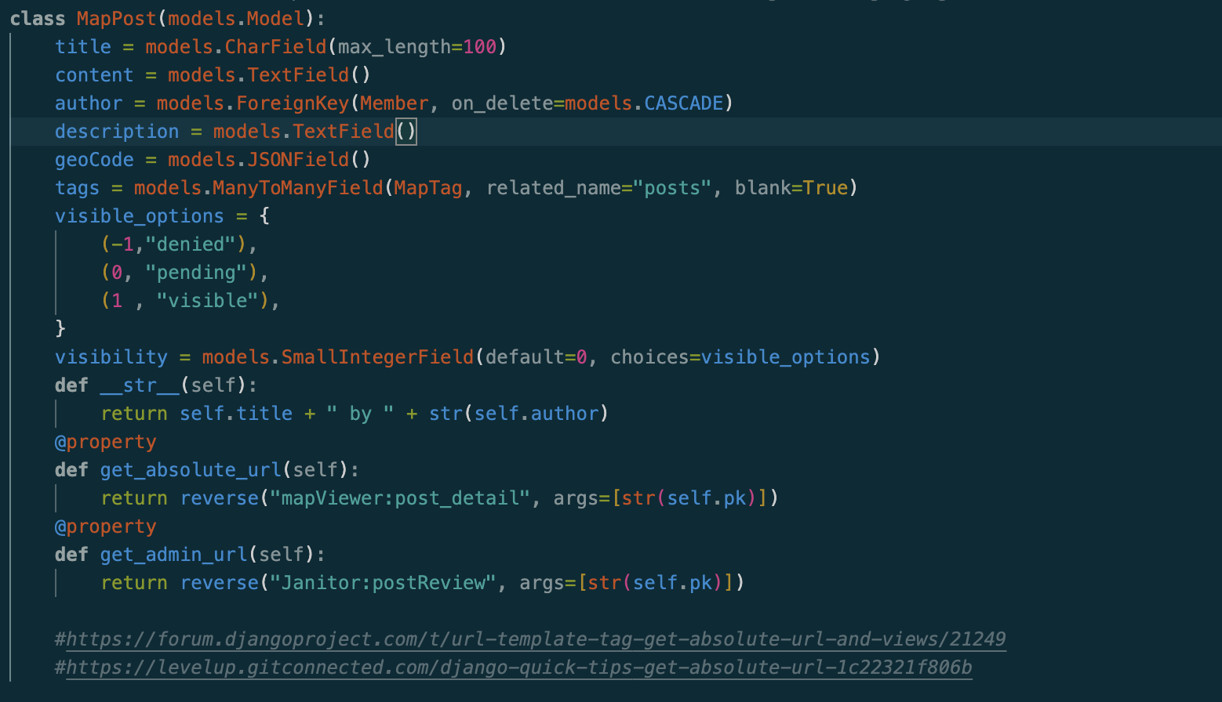
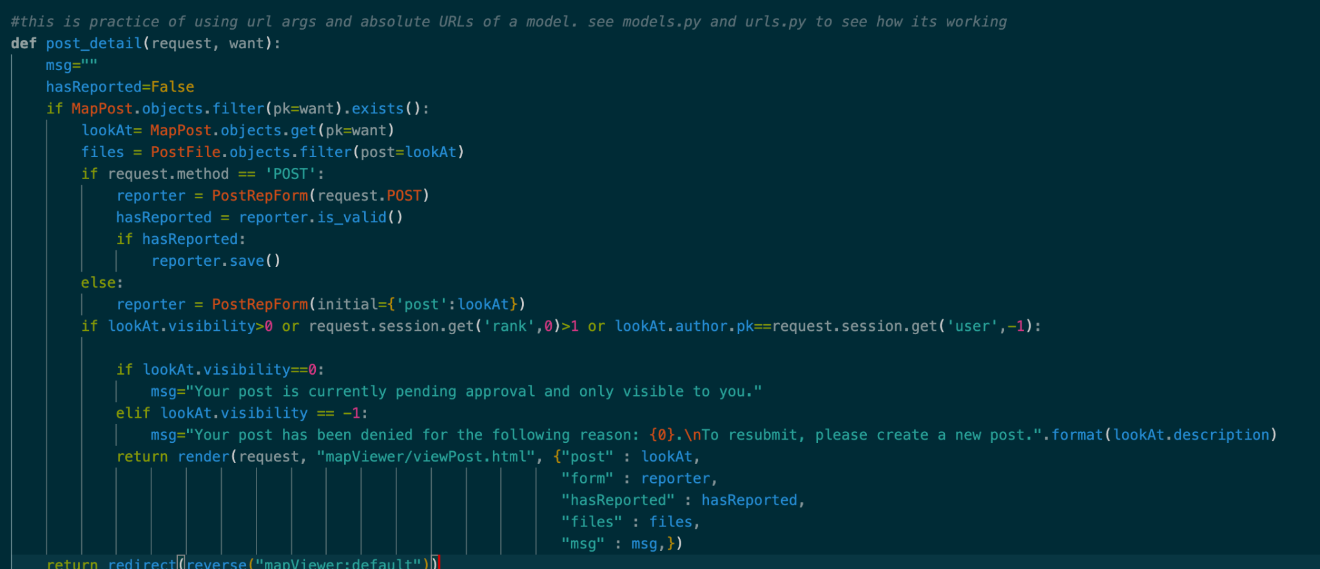
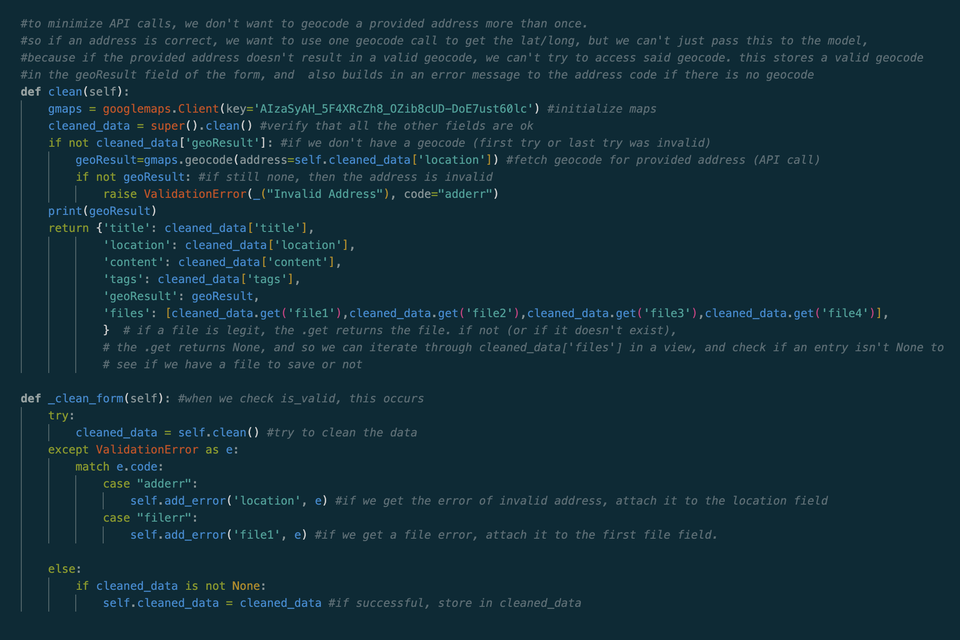
Dexter Mueller | MapViewer app
Models:
MapPost
MapTag
PostFile
Forms:
MakePostForm
SearchPostForm
Views:
viewMap
post_detail

Slide 11
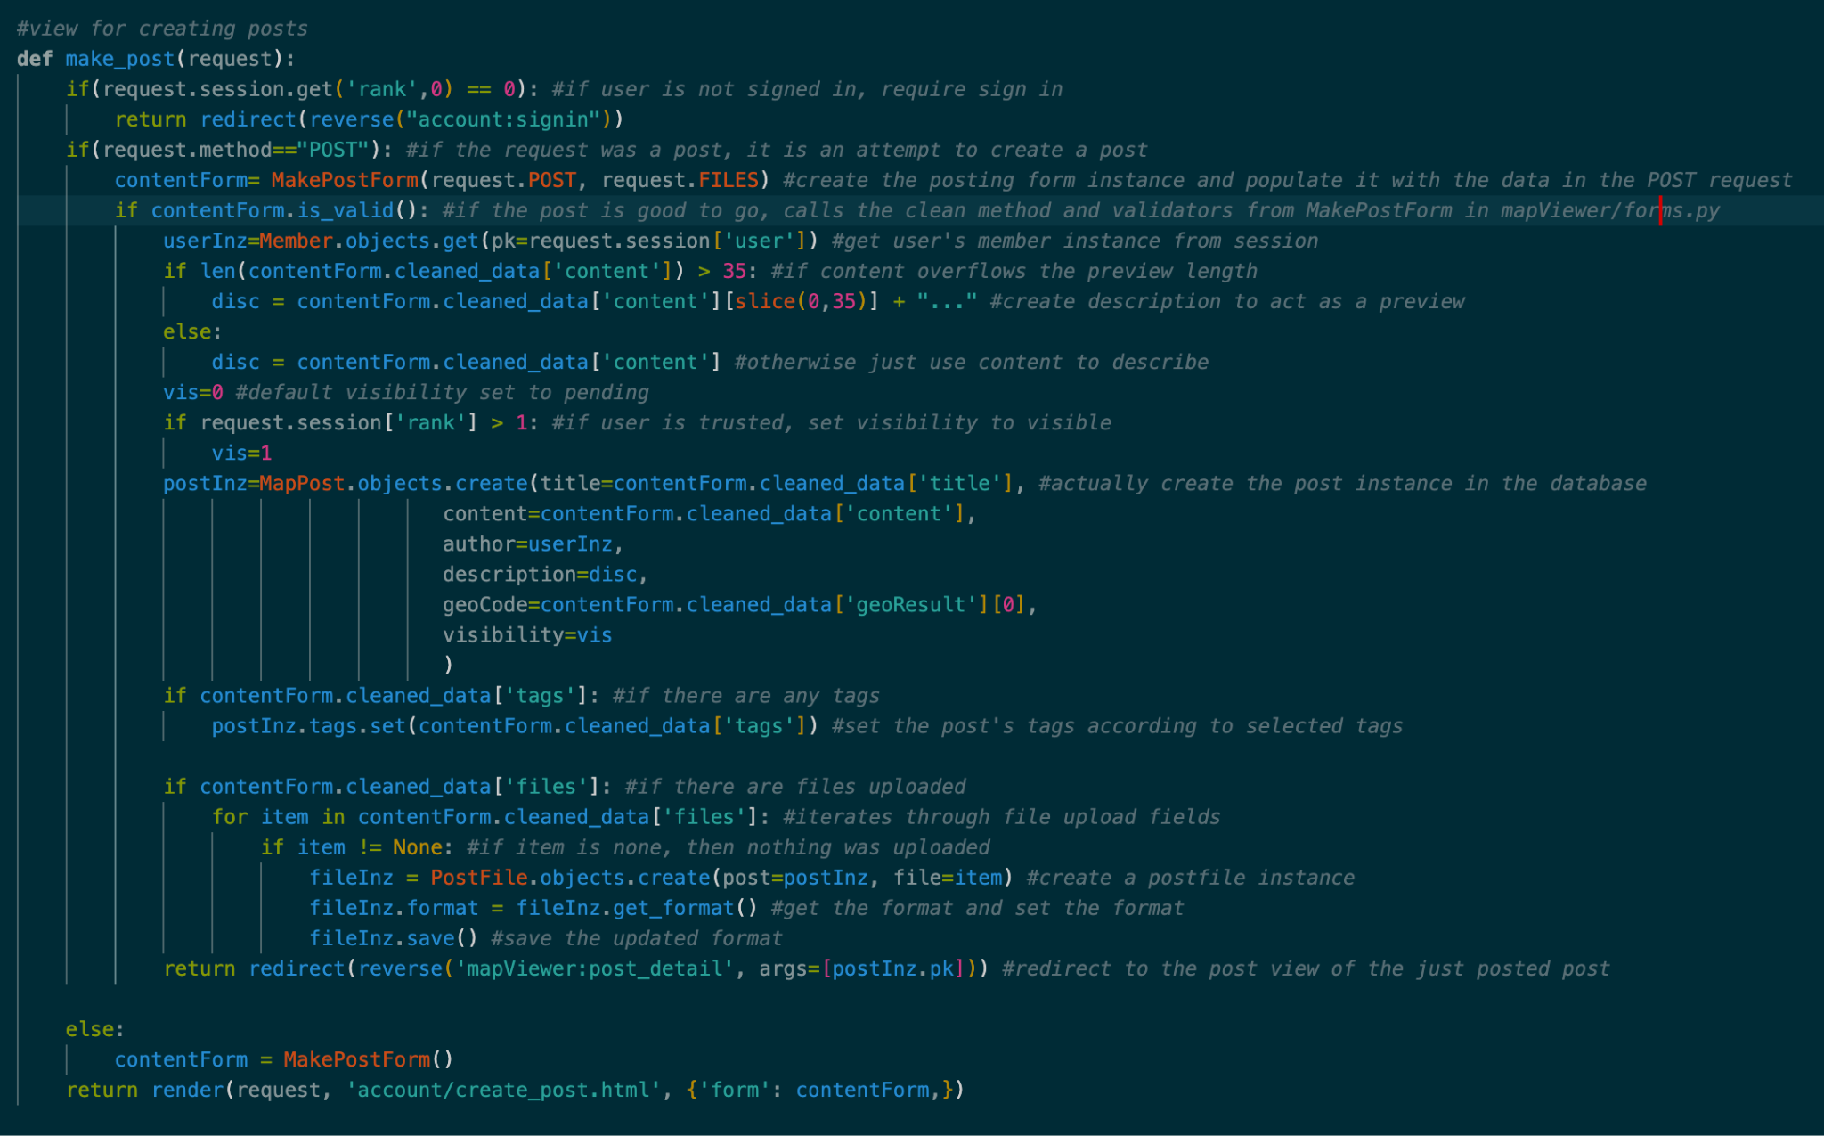
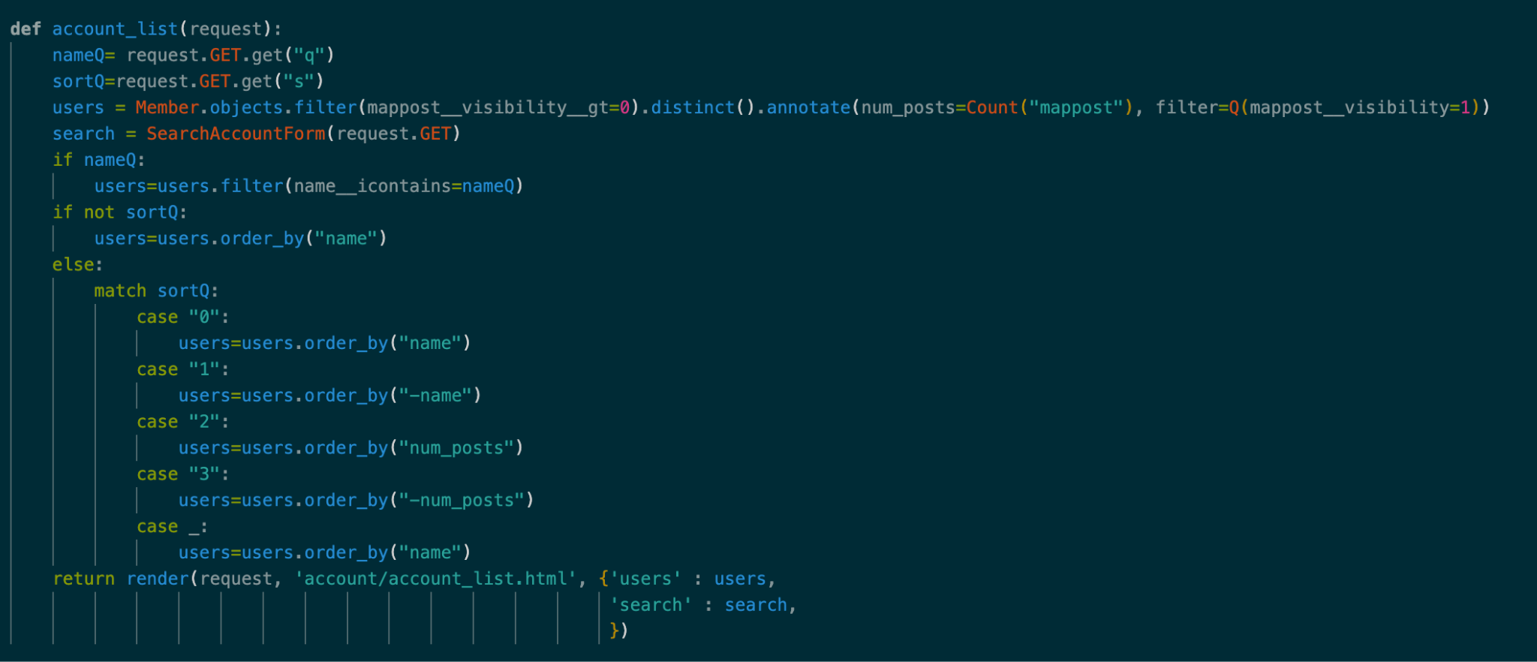
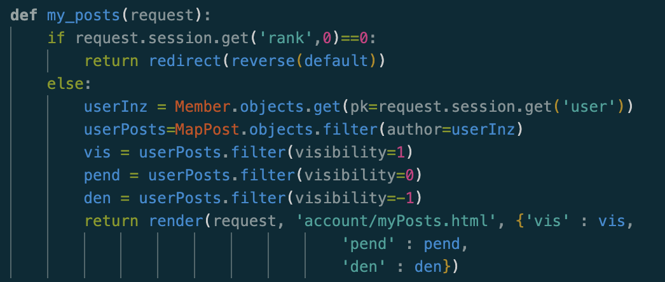
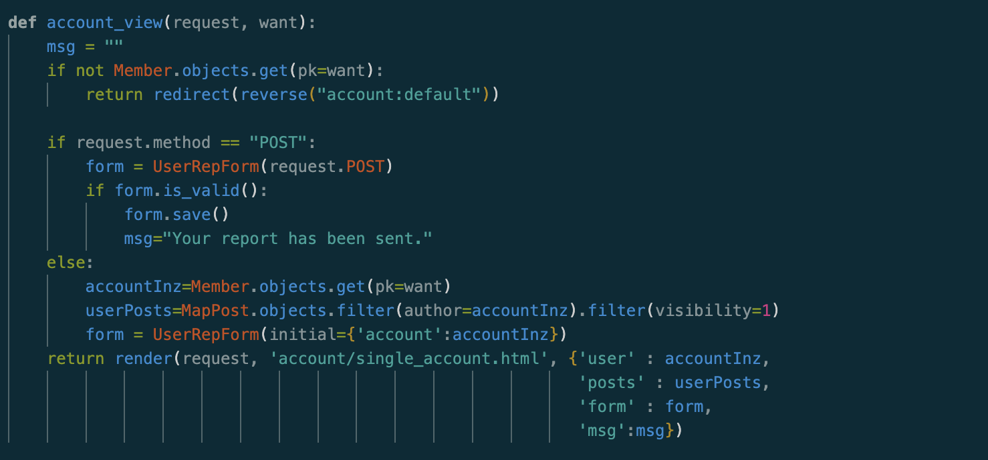
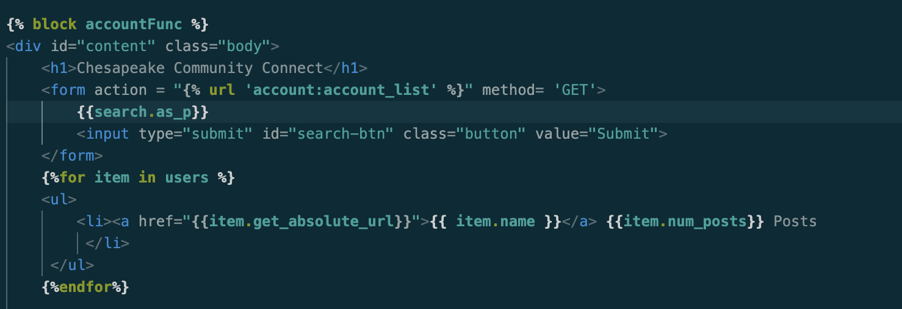
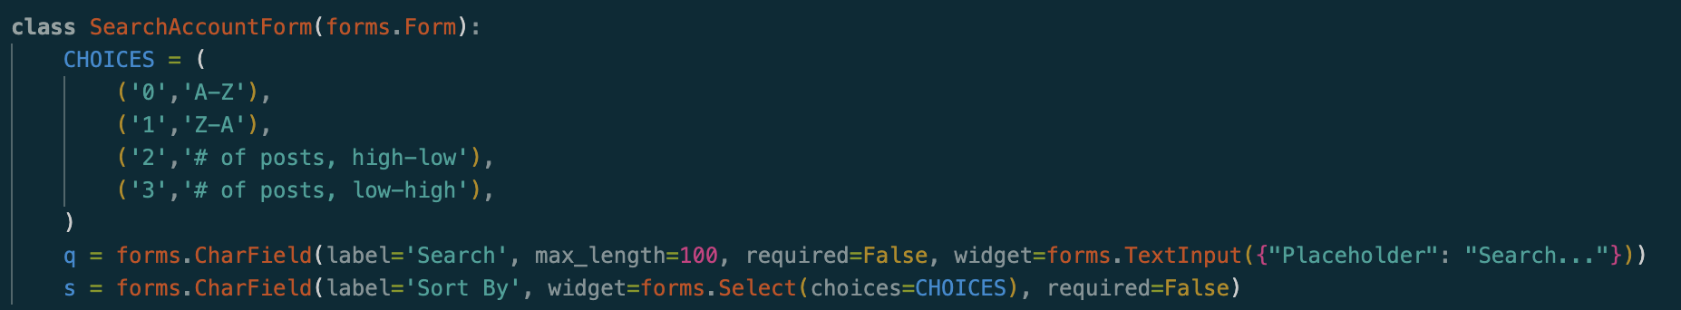
Dexter Mueller | account app
Views:
account_list
account_view
my_posts
make_post

Slide 12
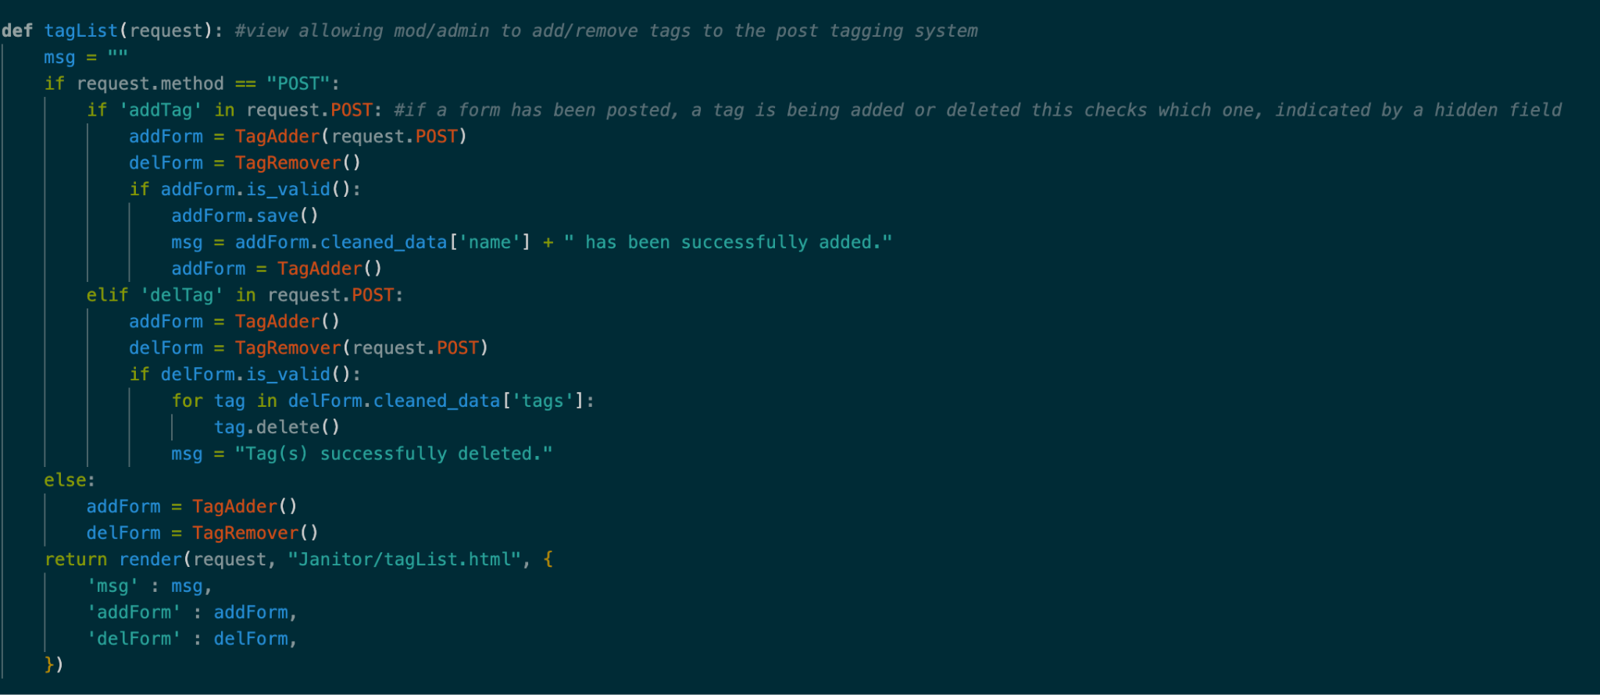
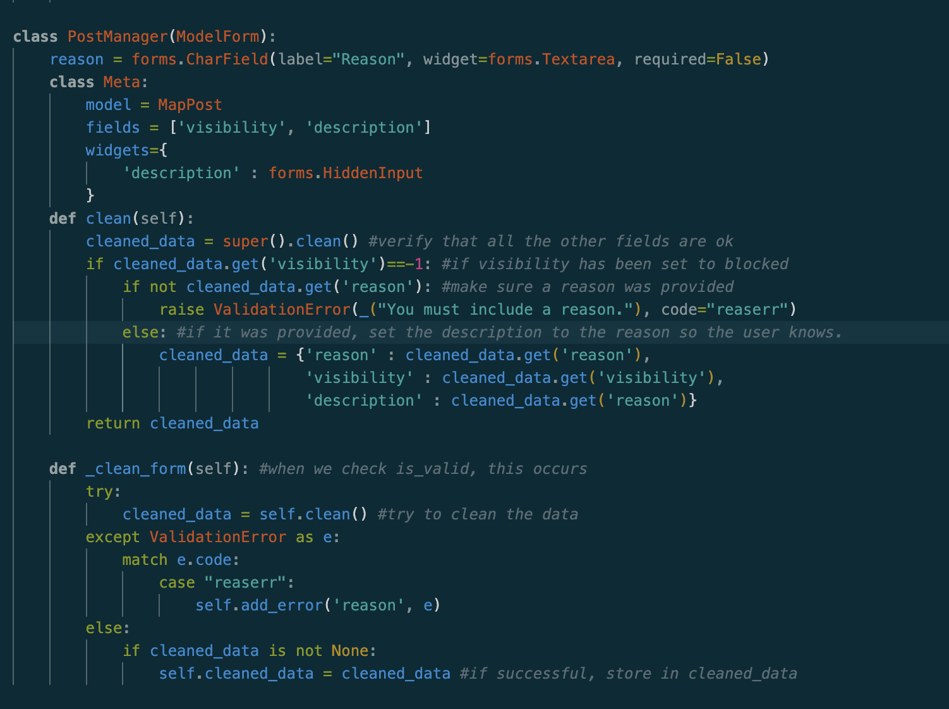
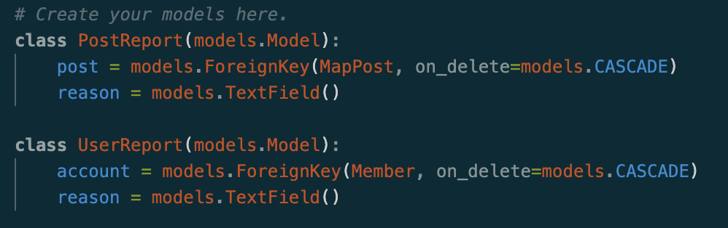
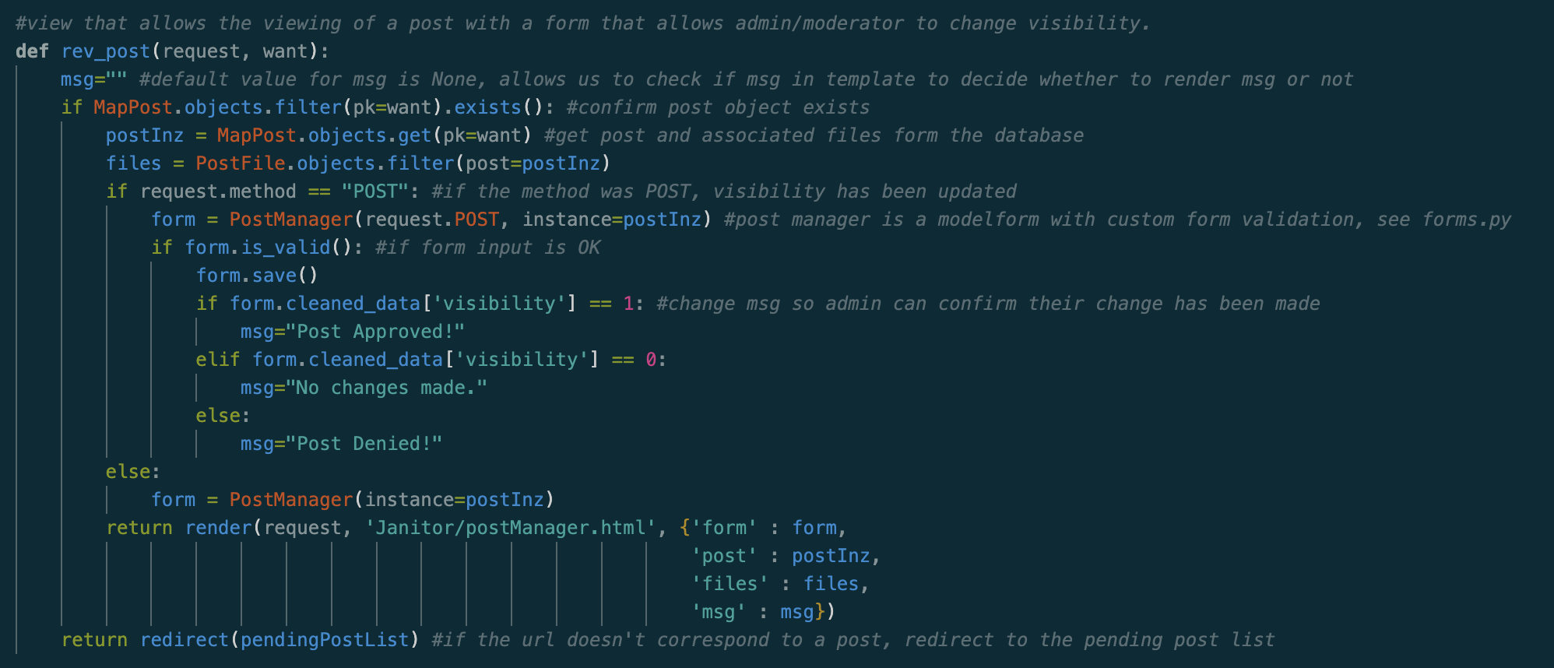
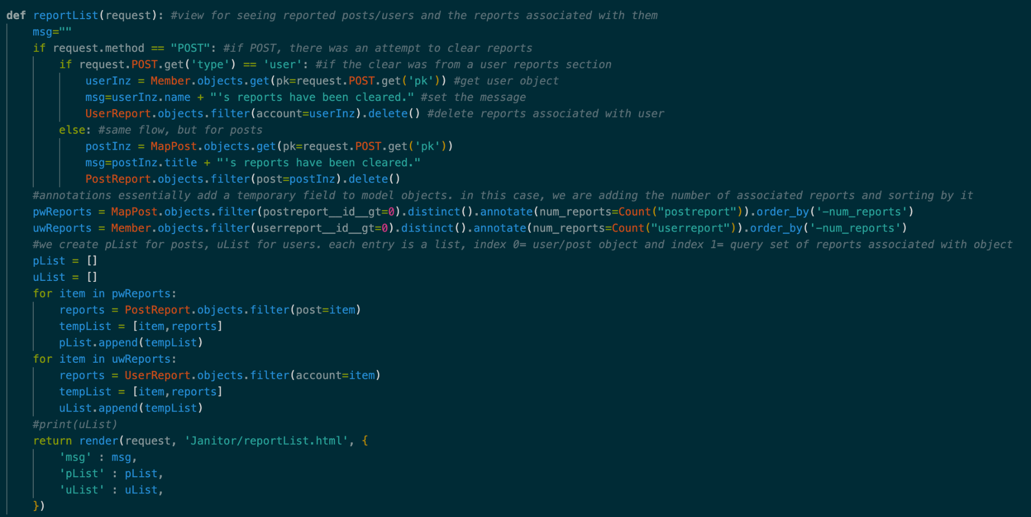
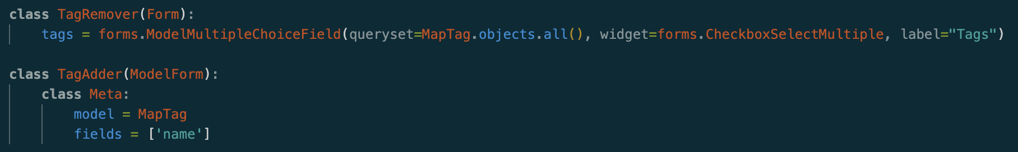
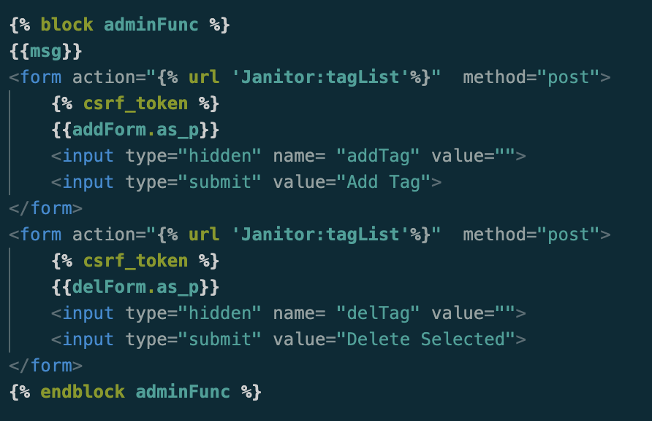
Dexter Mueller | Janitor app
Models
PostReport
UserReport
Forms
TagAdder/TagRemover
UserRepForm/PostRepForm
PostManager/UserManager
Views
contactList
memberList
member_manage
rev_post
tagList
reportList

Slide 13
Sam Albanese
Deployment
Deprecated all old package management code used for Microsoft Azure in favor of using Google Cloud
Google Cloud App Engine
Set up Google Cloud App Engine to host our website live using the Google Cloud Shell
Automatic Github Deployment was lost in this process, automating cloud deployment is more difficult than our previous method with Azure
API Key Management
Migrated API keys and Google Cloud utilities from personal accounts to the SMCM Project Manager account

Slide 14
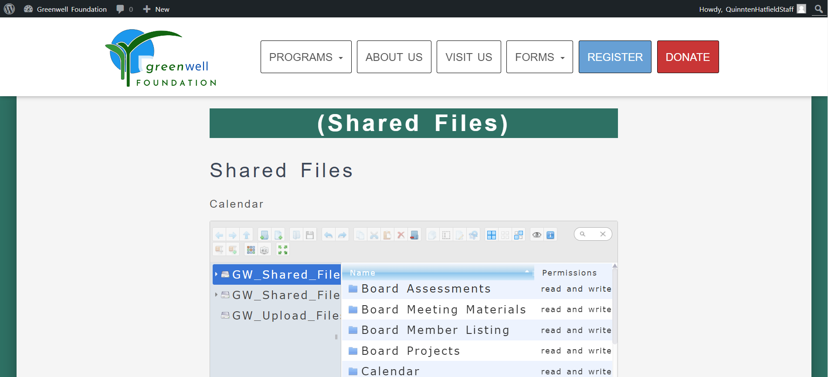
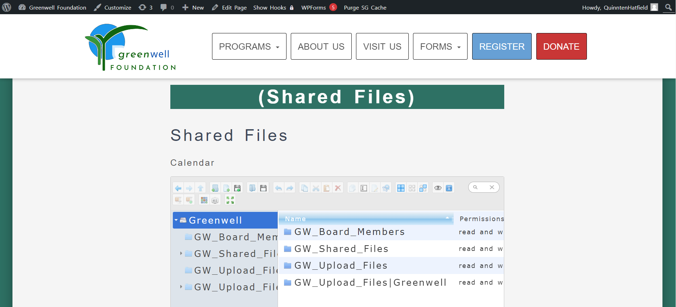
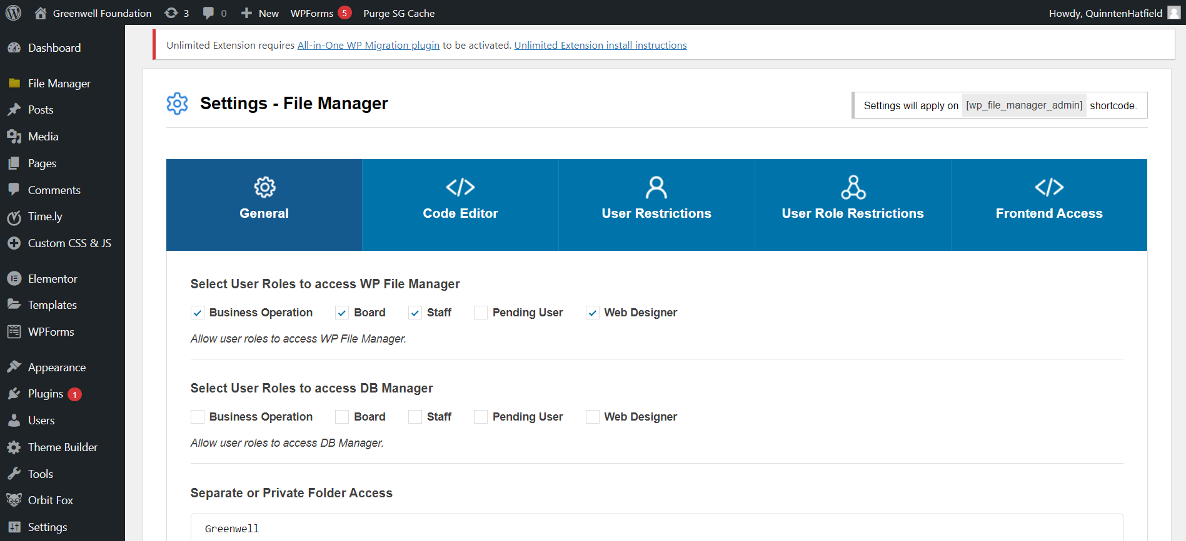
Quinnten Hatfield
Greenwell Foundation Website Private Folder Permissions
Created new instructions for admin to create private folders for specific member ranks.
CSS and HTML in Contributors and Admin pages
Contributors Page
Updated the sidebar button look.
Admin Page
Changed the accordion style and the button arrangement.

Slide 15
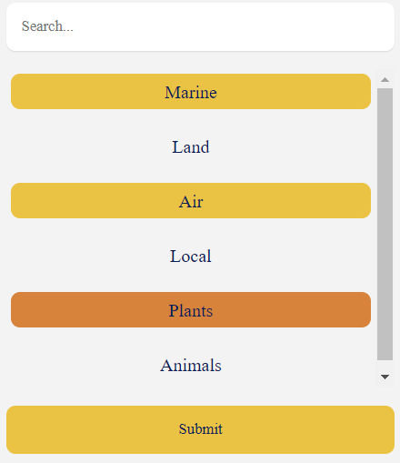
Roman Spiwak
Worked on Many Forms
Changed the Contact Us, the Search Posts, and the Create Posts forms.
Worked with Jeffery to create the Create an Account form.
Created clickable tags for the Search and Create Posts forms.
Standardized CSS files
Standardized the font and colors. Standardized the button class.

Slide 16
Quality Assurance

Slide 17
Daniel Reina
Addition to Primary Documents
SRS
Added the requirement of an editing option (similar to delete) for all accounts within the Admin Page. The Admin could edit the name of an account, the email, phone number.
Added in the requirement of the functionality to open up a specific contribution/upload through clicking on a button labeled “view more” at the bottom of the descriptive box.
Added functionality to the requirement “2.1.5.8 Admin Add a Filter.” Filter Creation.
STP
Created a PIVOT table within the STP excel test tracker to track progress.
Created codes for all test protocols.
New Document
User Manual
Created a User Manual draft, up to date on what we could explain usage.

Slide 18
Daniel Reina
Miscellaneous
Flier.
Traceability Matrix.
How to create QR code instructions.
Next Semester
Continues & Finish User Manual.
Update on flier.
Create about us video & finalize script.

Slide 19
Gavin McDonald
Document Creation and Updates
Created multiple documents for tracking progress and updated older documents
Training
Helped train people on Visual Studio Code and how to test the code in a reliable manner.
Website Testing and bug watching
Ran the development version of the website over it’s development, looking for any bugs or unintended features that popped up

Slide 20
John Heinig
Traceability matrix
Developed the traceability matrix to outline what website requirements were needed to implement functionalities
Testing
Ran various testing procedures as outlined in the STP
Video
Began work on creating the video that Parissa asked for, so far the script was created for next semester's team

Slide 21
Kendahl Toft
Website Flier
Collaborated with Alex Ochman in order to create a flier in Canva that is designed to attract interest in the project
Created a placeholder QR code in order to link from the flier to the website
Made instruction document so that when the link is finalized it can be used to update the QR code and flier
Undocumented Code Tracker
Marked several css and html documents for comments
Document Updates
Updated SRS with admin account edit function

Slide 22
Alex Ochman
Flyer
Collaborated with Kendahl Toft in order to create a flier in Canva that is designed to attract interest in the project
Went through 3 different drafts of the flyer
Documentation
Updated documentation; Specifically in the SRS
Code
Familiarized myself with code to make sure I was updating myself with any changes as well as testing mechanisms in the code when I was told to do so

Slide 23
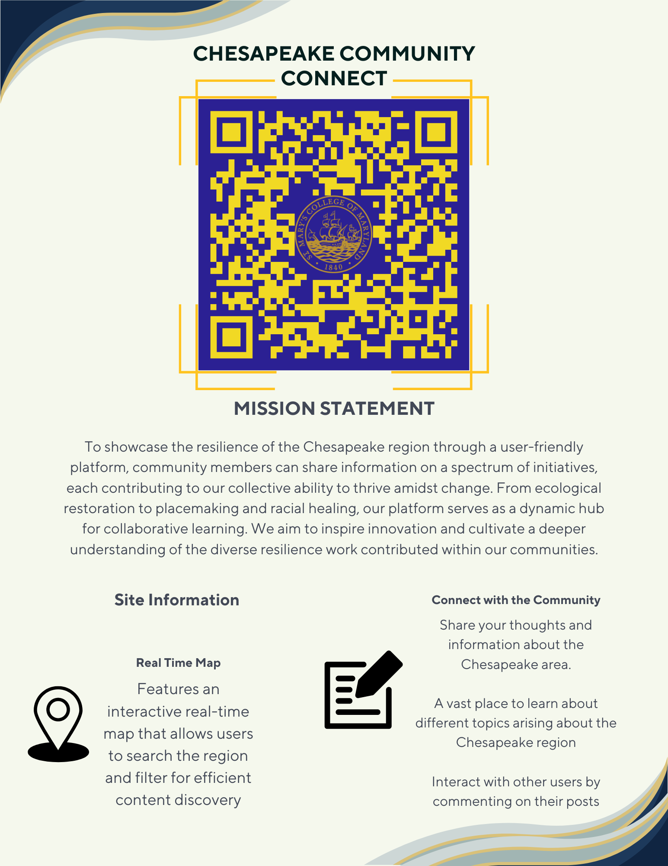

Slide 24
Michael Shively
Checking Code for Comments
Inspected .json, .html, and .css files for comments
Requirements Testing
Compiling list of testable requirements
Testing map requirements
Customer Presentation
Flier slide
Text Box Creation
Compiling list and writing text

Slide 25
Malik Hill
Creating new documents
Created Traceability matrix along with John Heinig to online and keep track of outline the requirements were to be tested and evaluated on
Along with Galvin created the user manual that will be a guide to work the website
Added upon the django tutorial document for next semester
Site testing
Tested on the about and contact us page of the website
Update STP and SRS
I along with john standardize all of the software test plan codes for testing procedure
Adding functionality to the requirement “2.1.5.8 Admin Add a Filter” to the SRS doc.

Slide 26
STUDENT NAME
Topic 1
This is what i did
Topic 2
This is what I did
Elaboration
This is what I did
Topic 3
This is what I did
Elaboration

Slide 27
STUDENT NAME
Topic 1
This is what i did
Topic 2
This is what I did
Elaboration
This is what I did
Topic 3
This is what I did
Elaboration

Slide 28
STUDENT NAME
Topic 1
This is what i did
Topic 2
This is what I did
Elaboration
This is what I did
Topic 3
This is what I did
Elaboration

Slide 29
STUDENT NAME
Topic 1
This is what i did
Topic 2
This is what I did
Elaboration
This is what I did
Topic 3
This is what I did
Elaboration

Slide 30
STUDENT NAME
Topic 1
This is what i did
Topic 2
This is what I did
Elaboration
This is what I did
Topic 3
This is what I did
Elaboration

Slide 31
STUDENT NAME
Topic 1
This is what i did
Topic 2
This is what I did
Elaboration
This is what I did
Topic 3
This is what I did
Elaboration

